Slide 1
Artificial Intelligence (AI)
Topic 3: A Knowledge Based Agent: Propositional Logic (Wumpus Problem) & Introduction to Inference Rules

Slide 2
Agenda
Knowledge Based Agents
Wumpus World
Logic in General – models and entailment
Propositional (Boolean) Logic
Equivalence, Validity, Satisfiability
Inference Rules and Theorem Proving
Forward Chaining
Backward Chaining
Resolution
Learning Outcomes : Intelligent Agents
Methodology and Assessment Criteria for the Subject

Slide 3
Logical Agents
Humans can know “things” and “reason”
Representation: How are the things stored?
Reasoning: How is the knowledge used?
To solve a problem…
To generate more knowledge…
Knowledge and reasoning are important to artificial agents because they enable successful behaviors difficult to achieve otherwise
Useful in partially observable environments
Can benefit from knowledge in very general forms, combining and recombining information

Slide 4
Knowledge-Based Agents
Central component of a Knowledge-Based Agent is a Knowledge-Base
A set of sentences in a formal language
Sentences are expressed using a knowledge representation language
Two generic functions:
TELL - add new sentences (facts) to the KB
“Tell it what it needs to know”
ASK - query what is known from the KB
“Ask what to do next”

Slide 5
Knowledge-Based Agents
Domain-Independent Algorithms
The agent must be able to:
Represent states and actions
Incorporate new percepts
Update internal representations of the world
Deduce hidden properties of the world
Deduce appropriate actions
Inference Engine
Knowledge-Base
Domain-Specific Content

Slide 6
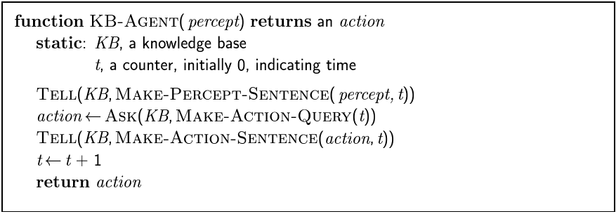
Knowledge-Based Agents(2)

Slide 7
Knowledge-Based Agents
Declarative
You can build a knowledge-based agent simply by “TELLing” it what it needs to know
Procedural
Encode desired behaviors directly as program code
Minimizing the role of explicit representation and reasoning can result in a much more efficient system

Slide 8
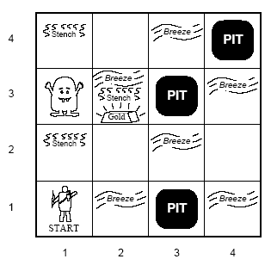
Wumpus World
Performance Measure
Gold +1000, Death – 1000
Step -1, Use arrow -10
Environment
Square adjacent to the Wumpus are smelly
Squares adjacent to the pit are breezy
Glitter iff gold is in the same square
Shooting kills Wumpus if you are facing it
Shooting uses up the only arrow
Grabbing picks up the gold if in the same square
Releasing drops the gold in the same square
Actuators
Left turn, right turn, forward, grab, release, shoot
Sensors
Breeze, glitter, and smell

Slide 9
Wumpus World
Characterization of Wumpus World
Observable
partial, only local perception
Deterministic
Yes, outcomes are specified
Episodic
No, sequential at the level of actions
Static
Yes, Wumpus and pits do not move
Discrete
Yes
Single Agent
Yes

Slide 10
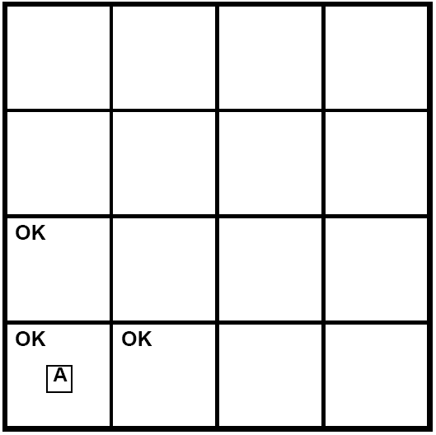
Wumpus World

Slide 11
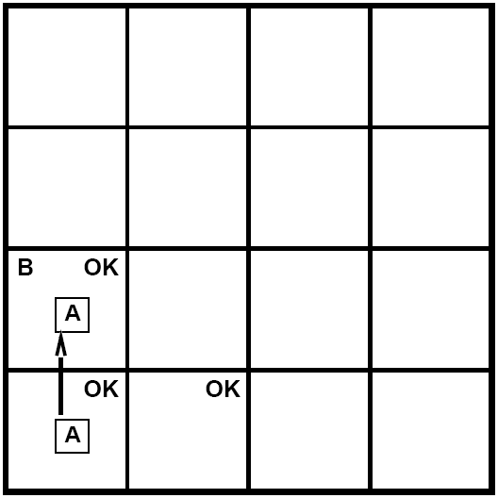
Wumpus World

Slide 12
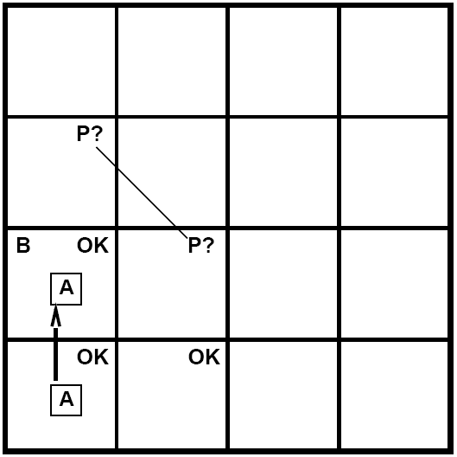
Wumpus World

Slide 13
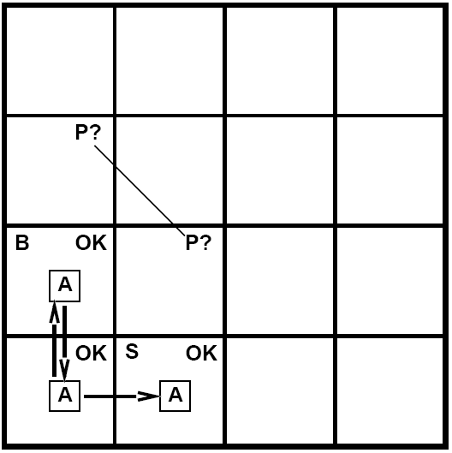
Wumpus World

Slide 14
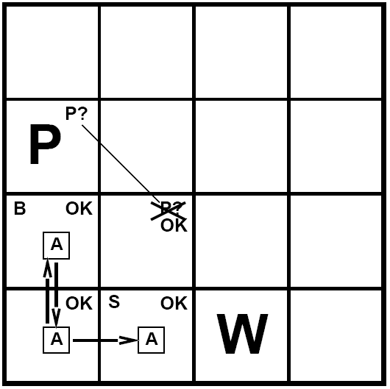
Wumpus World

Slide 15
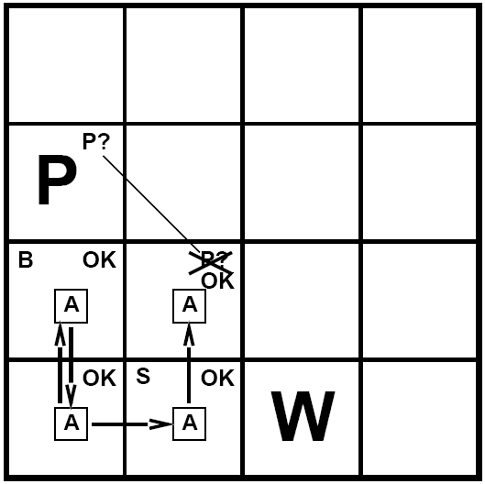
Wumpus World

Slide 16
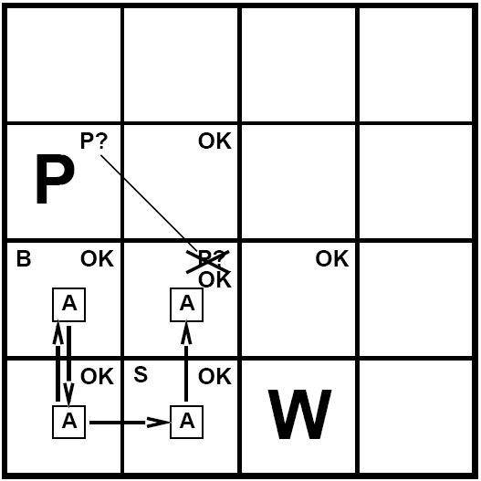
Wumpus World

Slide 17
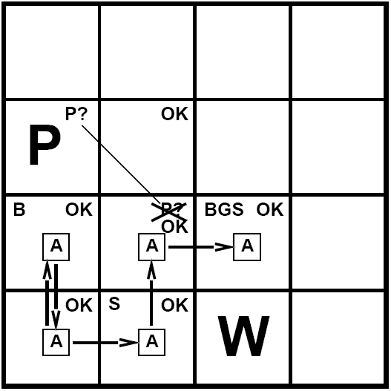
Wumpus World

Slide 18
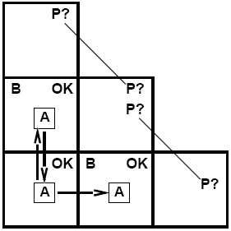
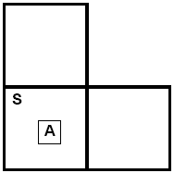
Other Sticky Situations
Breeze in (1,2) and (2,1)
No safe actions
Smell in (1,1)
Cannot move

Slide 19
Logic
Knowledge bases consist of sentences in a formal language
Syntax
Sentences are well formed
Semantics
The “meaning” of the sentence
The truth of each sentence with respect to each possible world (model)
Example:
x + 2 >= y is a sentence
x2 + y > is not a sentence
x + 2 >= y is true iff x + 2 is no less than y
x + 2 >= y is true in a world where x = 7, y=1
x + 2 >= y is false in world where x = 0, y =6

Slide 20
Logic
Entailment means that one thing follows logically from another
a |= b
a |= b iff in every model in which a is true, b is also true
if a is true, then b must be true
the truth of b is “contained” in the truth of a

Slide 21
Logic
Example:
A KB containing
“Cleveland won”
“Dallas won”
Entails…
“Either Cleveland won or Dallas won”
Example:
x + y = 4 entails 4 = x + y

Slide 22
Logic
A model is a formally structured world with respect to which truth can be evaluated
M is a model of sentence a if a is true in m
Then KB |= a if M(KB) ⊆ M(a)
M(α)
x
x x x x x x x x xx
x x x x x x x x
x x x x x x x x x
xxx x x xx x x x
xxx x x x x x x x x
M(KB)
x x x x
x x x x
x x x
x

Slide 23
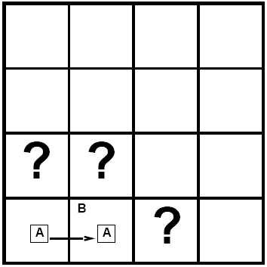
Logic
Entailment in Wumpus World
Situation after detecting nothing in [1,1], moving right, breeze in [2,1]
Consider possible models for ? assuming only pits
3 Boolean choices => 8 possible models

Slide 24
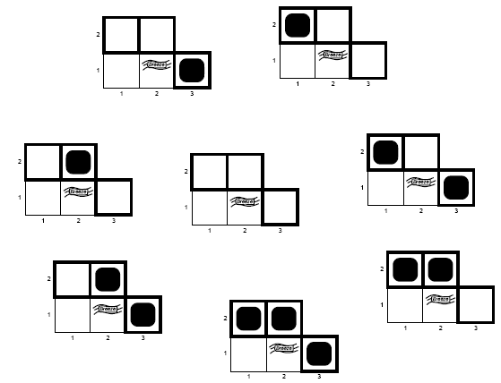
Logic

Slide 25
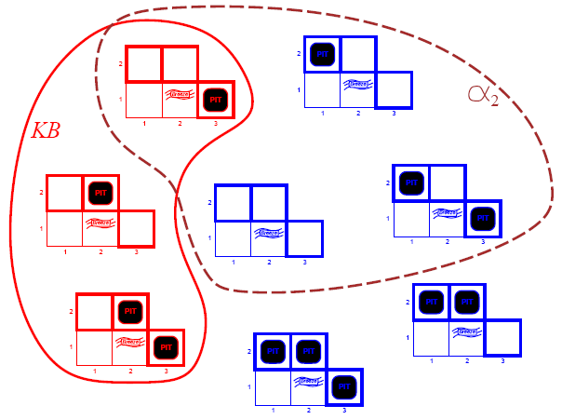
Logic
KB = wumpus world rules + observations
α₂ = “[2,2] is safe”, KB ¬|= α₂ proved by model checking

Slide 26
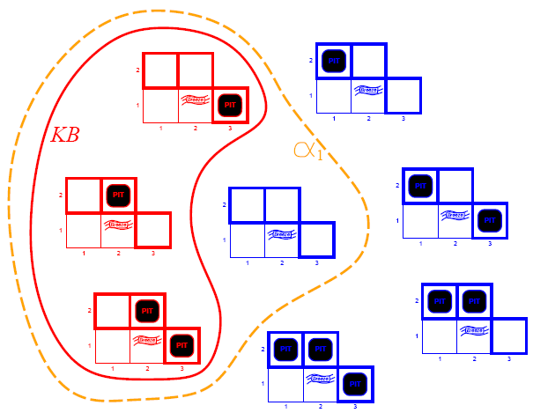
Logic
KB = wumpus world rules + observations
α₁ = “[1,2] is safe”, KB |= α₁, proved by model checking

Slide 27
Logic
Inference is the process of deriving a specific sentence from a KB (where the sentence must be entailed by the KB)
KB |-_{i} a = sentence a can be derived from KB by procedure I
“KB’s are a haystack”
Entailment = needle in haystack
Inference = finding it

Slide 28
Logic
Soundness
i is sound if…
whenever KB |-_{i} α is true, KB |= α is true
Completeness
i is complete if
whenever KB |= α is true, KB |-_{i} α is true
If KB is true in the real world, then any sentence α derived from KB by a sound inference procedure is also true in the real world

Slide 29
Propositional Logic
AKA Boolean Logic
False and True
Proposition symbols P1, P2, etc are sentences
NOT: If S1 is a sentence, then ¬S1 is a sentence (negation)
AND: If S1, S2 are sentences, then S1 ∧ S2 is a sentence (conjunction)
OR: If S1, S2 are sentences, then S1 ∨ S2 is a sentence (disjunction)
IMPLIES: If S1, S2 are sentences, then S1 ⇒ S2 is a sentence (implication)
IFF: If S1, S2 are sentences, then S1 ⇔ S2 is a sentence (biconditional)

Slide 30
Propositional Logic
P | Q | ¬P | P∧Q | P∨Q | P⇒Q | P⇔Q
False | False | True | False | False | True | True
False | True | True | False | True | True | False
True | False | False | False | True | False | False
True | True | False | True | True | True | True

Slide 31
Wumpus World Sentences
Let P_{i,j} be True if there is a pit in [i,j]
Let B_{i,j} be True if there is a breeze in [i,j]
¬P_{1,1}
¬ B_{1,1}
B_{2,1}
“Pits cause breezes in adjacent squares”
B_{1,1} ⇔ (P_{1,2} ∨ P_{2,1})
B_{2,1} ⇔ (P_{1,1} ∨ P_{2,1} ∨ P_{3,1})
A square is breezy if and only if there is an adjacent pit

Slide 32
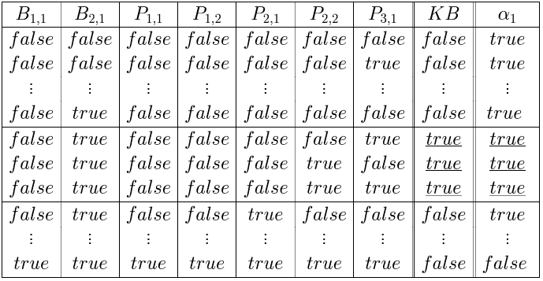
A Simple Knowledge Base

Slide 33

A Simple Knowledge Base
R1: ¬P_{1,1}
R2: B_{1,1} ⇔ (P_{1,2} ∨ P_{2,1})
R3: B_{2,1} (P_{1,1} ∨ P_{2,2} ∨ P_{3,1})
R4: ¬ B_{1,1}
R5: B_{2,1}
KB consists of sentences R₁ thru R₅
R1 ∧ R2 ∧ R3 ∧ R4 ∧ R5

Slide 34
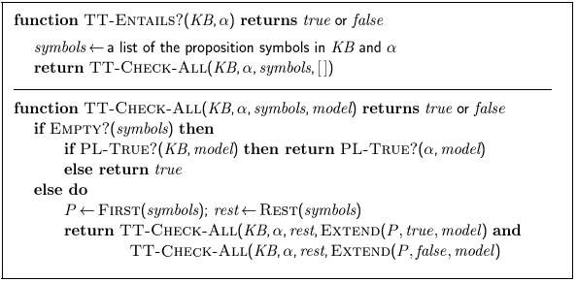
A Simple Knowledge Base
Every known inference algorithm for propositional logic has a worst-case complexity that is exponential in the size of the input. (co-NP complete)

Slide 35
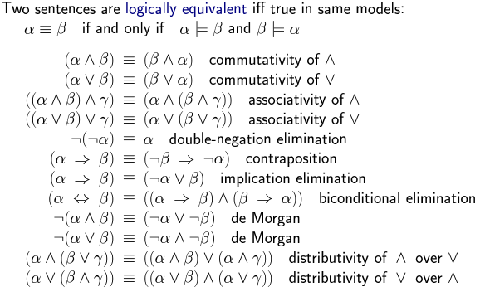
Equivalence, Validity, Satisfiability

Slide 36
Equivalence, Validity, Satisfiability
A sentence if valid if it is true in all models
e.g. True, A ∨ ¬A, A ⇒ A, (A ∧ (A ⇒ B) ⇒ B
Validity is connected to inference via the Deduction Theorem
KB |- a iff (KB ⇒ a) is valid
A sentence is satisfiable if it is True in some model
e.g. A ∨ B, C
A sentence is unstatisfiable if it is True in no models
e.g. A ∧ ¬A
Satisfiability is connected to inference via the following
KB |= a iff (KB ∧ ¬a) is unsatisfiable
proof by contradiction

Slide 37
Reasoning Patterns
Inference Rules
Patterns of inference that can be applied to derive chains of conclusions that lead to the desired goal.
Modus Ponens
Given: S1 ⇒ S2 and S1, derive S2
And-Elimination
Given: S1 ∧ S2, derive S1
Given: S1 ∧ S2, derive S2
DeMorgan’s Law
Given: ¬( A ∨ B) derive ¬A ∧ ¬B
Given: ¬( A ∧ B) derive ¬A ∨ ¬B

Slide 38
Reasoning Patterns
Modus Ponens
Whenever sentences of the form α ⇒ β and α are given, then sentence β can be inferred
(WumpusAhead ∧ WumpusAlive) ⇒ Shoot and (WumpusAhead ∧ WumpusAlive), Shoot can be inferred
And Elimination
From a conjunction, any of the conjuncts can be inferred
(WumpusAhead ∧ WumpusAlive), WumpusAlive can be inferred

Slide 39
Example Proof By Deduction
Knowledge
S1: B₂₂ ⇔ ( P₂₁ ∨ P₂₃ ∨ P₁₂ ∨ P₃₂ ) rule
S2: ¬B₂₂ observation
Inferences
S3: (B₂₂ ⇒ (P₂₁ ∨ P₂₃ ∨ P₁₂ ∨ P₃₂ ))∧ ((P₂₁ ∨ P₂₃ ∨ P₁₂ ∨ P₃₂ ) ⇒ B₂₂) [S1,bi elim]
S4: ((P₂₁ ∨ P₂₃ ∨ P₁₂ ∨ P₃₂ ) ⇒ B₂₂) [S3, and elim]
S5: (¬B₂₂ ⇒ ¬( P₂₁ ∨ P₂₃ ∨ P₁₂ ∨ P₃₂ )) [contrapos]
S6: ¬(P₂₁ ∨ P₂₃ ∨ P₁₂ ∨ P₃₂ ) [S2,S6, MP]
S7: ¬P₂₁ ∧ ¬P₂₃ ∧ ¬P₁₂ ∧ ¬P₃₂ [S6, DeMorg]

Slide 40
Evaluation of Deductive Inference
Sound
Yes, because the inference rules themselves are sound. (This can be proven using a truth table argument).
Complete
If we allow all possible inference rules, we’re searching in an infinite space, hence not complete
If we limit inference rules, we run the risk of leaving out the necessary one…
Monotonic
If we have a proof, adding information to the DB will not invalidate the proof

Slide 41
Resolution
Resolution allows a complete inference mechanism (search-based) using only one rule of inference
Resolution rule:
Given: P₁ ∨ P₂ ∨ P_{3 …}∨ P_{n,} and ¬P₁ ∨ Q_{1 …}∨ Q_{m}
Conclude: P₂ ∨ P_{3 …}∨ P_{n} ∨ Q_{1 …}∨ Q_{m}
Complementary literals P₁ and ¬P₁ “cancel out”
Why it works:
Consider 2 cases: P₁ is true, and P₁ is false

Slide 42
Resolution in Wumpus World
There is a pit at 2,1 or 2,3 or 1,2 or 3,2
P₂₁ ∨ P₂₃ ∨ P₁₂ ∨ P₃₂
There is no pit at 2,1
¬P₂₁
Therefore (by resolution) the pit must be at 2,3 or 1,2 or 3,2
P₂₃ ∨ P₁₂ ∨ P₃₂

Slide 43
Proof using Resolution
To prove a fact P, repeatedly apply resolution until either:
No new clauses can be added, (KB does not entail P)
The empty clause is derived (KB does entail P)
This is proof by contradiction: if we prove that KB ∧ ¬P derives a contradiction (empty clause) and we know KB is true, then ¬P must be false, so P must be true!
To apply resolution mechanically, facts need to be in Conjunctive Normal Form (CNF)
To carry out the proof, need a search mechanism that will enumerate all possible resolutions.

Slide 44
CNF Example
B₂₂ ⇔ ( P₂₁ ∨ P₂₃ ∨ P₁₂ ∨ P₃₂ )
Eliminate ⇔ , replacing with two implications
(B₂₂ ⇒ ( P₂₁ ∨ P₂₃ ∨ P₁₂ ∨ P₃₂ )) ∧ ((P₂₁ ∨ P₂₃ ∨ P₁₂ ∨ P₃₂ ) ⇒ B₂₂)
Replace implication (A ⇒ B) by ¬A ∨ B
(¬B₂₂ ∨ ( P₂₁ ∨ P₂₃ ∨ P₁₂ ∨ P₃₂ )) ∧ (¬(P₂₁ ∨ P₂₃ ∨ P₁₂ ∨ P₃₂ ) ∨ B₂₂)
Move ¬ “inwards” (unnecessary parens removed)
(¬B₂₂ ∨ P₂₁ ∨ P₂₃ ∨ P₁₂ ∨ P₃₂ ) ∧ ( (¬P₂₁ ∧ ¬P₂₃ ∧ ¬P₁₂ ∧ ¬P₃₂ ) ∨ B₂₂)
5. Distributive Law
(¬B₂₂ ∨ P₂₁ ∨ P₂₃ ∨ P₁₂ ∨ P₃₂ ) ∧ (¬P₂₁ ∨ B₂₂) ∧ (¬P₂₃ ∨ B₂₂) ∧ (¬P₁₂ ∨ B₂₂) ∧ (¬P₃₂ ∨ B₂₂)
(Final result has 5 clauses)

Slide 45
Resolution Example
Given B₂₂ and ¬P₂₁ and ¬P₂₃ and ¬P₃₂ , prove P₁₂
(¬B₂₂ ∨ P₂₁ ∨ P₂₃ ∨ P₁₂ ∨ P₃₂ ) ; ¬P₁₂
(¬B₂₂ ∨ P₂₁ ∨ P₂₃ ∨ P₃₂ ) ; ¬P₂₁
(¬B₂₂ ∨ P₂₃ ∨ P₃₂ ) ; ¬P₂₃
(¬B₂₂ ∨ P₃₂ ) ; ¬P₃₂
(¬B₂₂) ; B₂₂
[empty clause]

Slide 46
Evaluation of Resolution
Resolution is sound
Because the resolution rule is true in all cases
Resolution is complete
Provided a complete search method is used to find the proof, if a proof can be found it will
Note: you must know what you’re trying to prove in order to prove it!
Resolution is exponential
The number of clauses that we must search grows exponentially…

Slide 47
Horn Clauses
A Horn Clause is a CNF clause with exactly one positive literal
The positive literal is called the head
The negative literals are called the body
Prolog: head:- body1, body2, body3 …
English: “To prove the head, prove body1, …”
Implication: If (body1, body2 …) then head
Horn Clauses form the basis of forward and backward chaining
The Prolog language is based on Horn Clauses
Deciding entailment with Horn Clauses is linear in the size of the knowledge base

Slide 48
Reasoning with Horn Clauses
Forward Chaining
For each new piece of data, generate all new facts, until the desired fact is generated
Data-directed reasoning
Backward Chaining
To prove the goal, find a clause that contains the goal as its head, and prove the body recursively
(Backtrack when you chose the wrong clause)
Goal-directed reasoning
Notes:
Skipping 7.6+

Slide 49
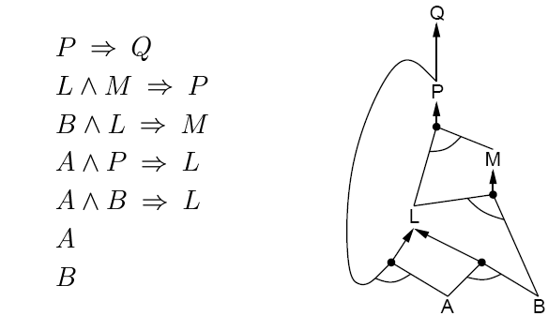
Forward Chaining
Fire any rule whose premises are satisfied in the KB
Add its conclusion to the KB until the query is found

Slide 50
Forward Chaining (2)
AND-OR Graph
multiple links joined by an arc indicate conjunction – every link must be proved
multiple links without an arc indicate disjunction – any link can be proved

Slide 51
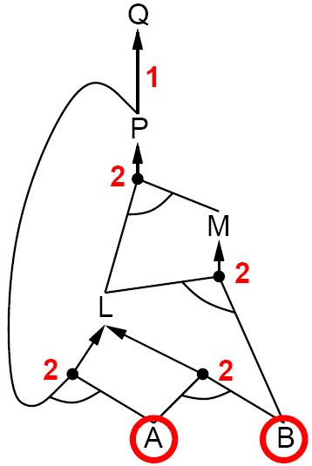
Forward Chaining (3)

Slide 52
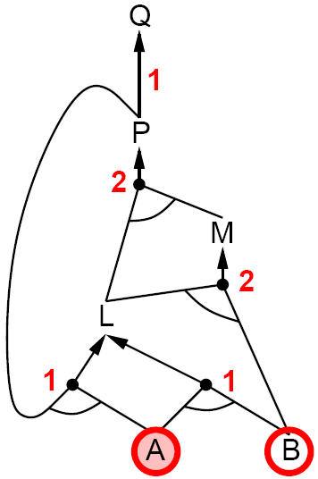
Forward Chaining (4)

Slide 53
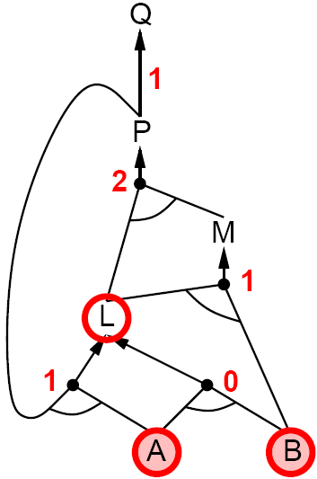
Forward Chaining (5)

Slide 54
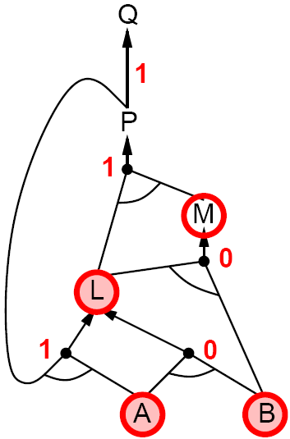
Forward Chaining (6)

Slide 55
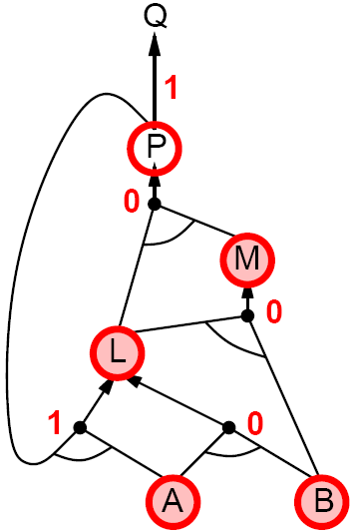
Forward Chaining (7)

Slide 56
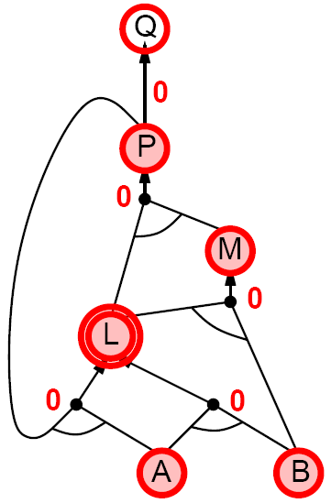
Forward Chaining (8)

Slide 57
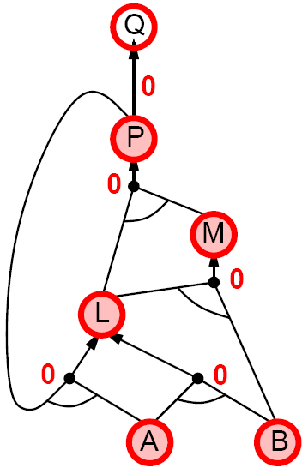
Forward Chaining (9)

Slide 58
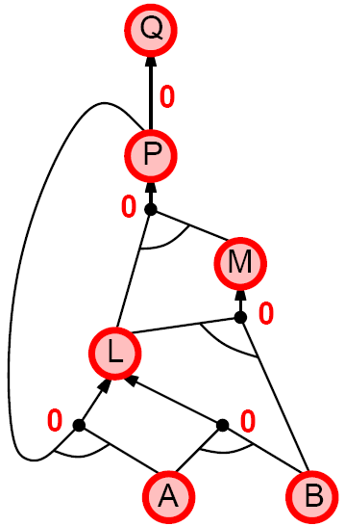
Forward Chaining (10)

Slide 59
Backward Chaining (1)
Idea: work backwards from the query q:
To prove q by BC,
Check if q is known already, or
Prove by BC all premises of some rule concluding q
Avoid loops
Check if new subgoal is already on the goal stack
Avoid repeated work: check if new subgoal
Has already been proved true, or
Has already failed

Slide 60
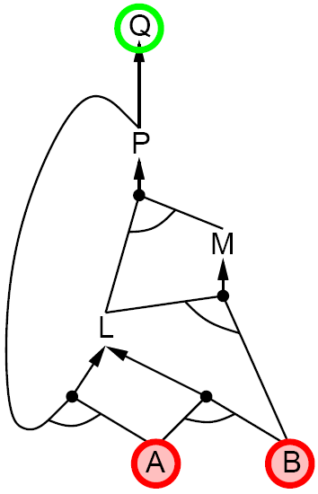
Backward Chaining (2)

Slide 61
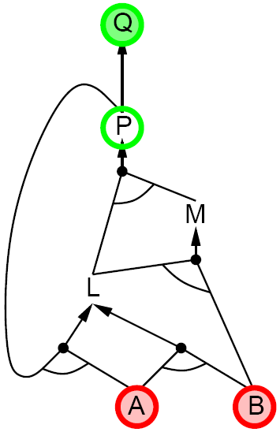
Backward Chaining (3)

Slide 62
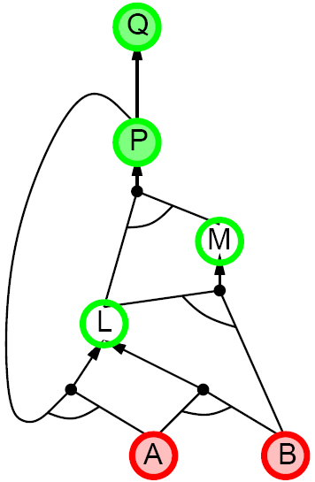
Backward Chaining (4)

Slide 63
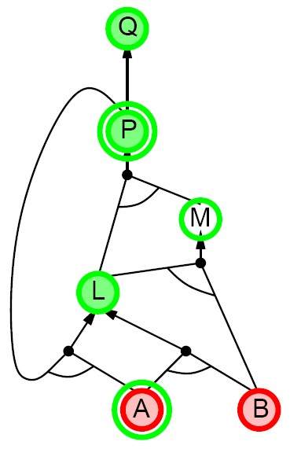
Backward Chaining (5)

Slide 64
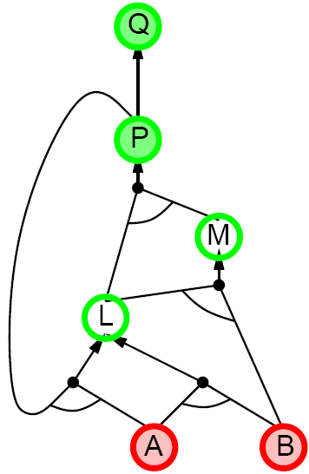
Backward Chaining (6)

Slide 65
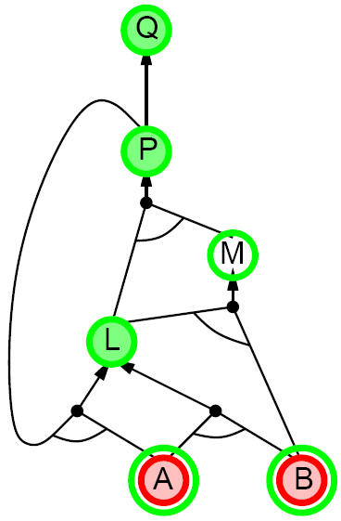
Backward Chaining (7)

Slide 66
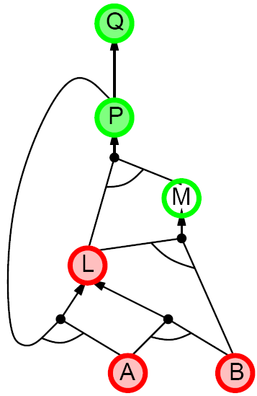
Backward Chaining (8)

Slide 67
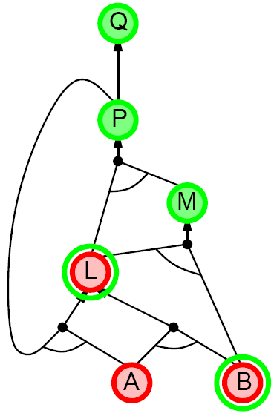
Backward Chaining (9)

Slide 68
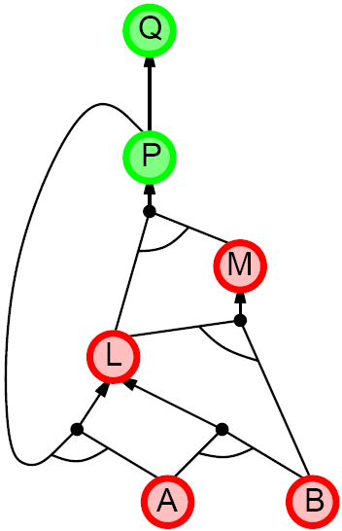
Backward Chaining (10)

Slide 69
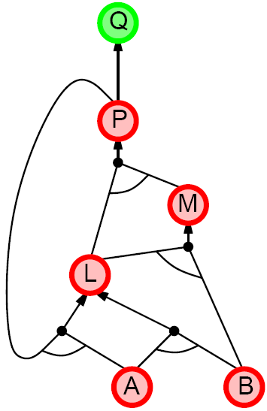
Backward Chaining (11)

Slide 70
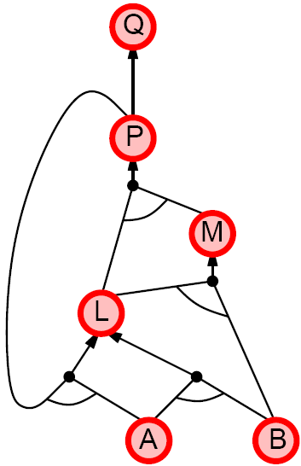
Backward Chaining (12)

Slide 71
Forward Chaining vs. Backward Chaining
Forward Chaining is data driven
Automatic, unconscious processing
E.g. object recognition, routine decisions
May do lots of work that is irrelevant to the goal
Backward Chaining is goal driven
Appropriate for problem solving
E.g. “Where are my keys?”, “How do I start the car?”
The complexity of BC can be much less than linear in size of the KB

Slide 72
Methodology And Assessment Criterias
Class Assignment(s)
Each chapter being covered will have one assignment. The Case Studies will be given in line to the Changing with Speed across IT Projects in Kirirom
Internal Exam(s)
There will be 2 exams
Model Exam
There will be one Model Exam.
Semester Exam
There will be 1 Semester Exam

Slide 73
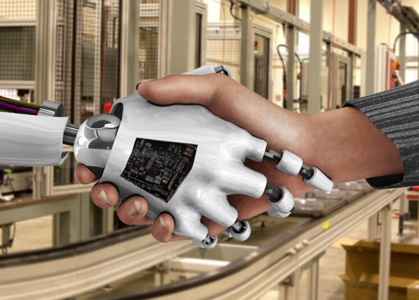
Thank You !
“An Algorithm Must Be Seen to Be Believed”
- Donald Knuth

